Slide 1
Inference Engine: TF vs. TFLite

Slide 2


ML Workflow
this course
next course
Collect
Data
Preprocess
Data
Design a
Model
Train a
Model
Evaluate
Optimize
Convert
Model
Deploy
Model
Make
Inferences
Micro

Slide 4
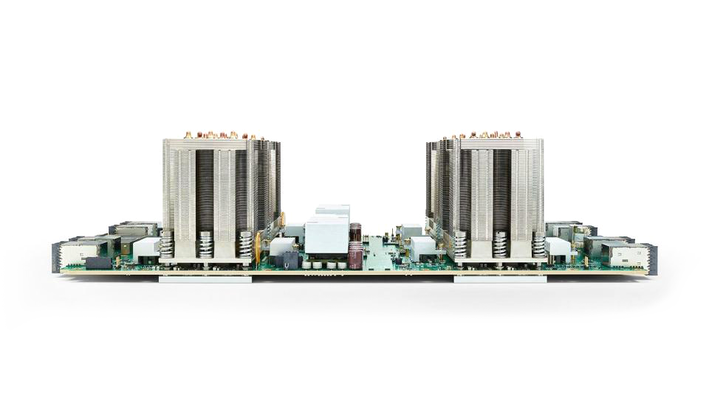
Notes:
https://commons.wikimedia.org/wiki/File:TensorFlow_Logo_with_text.png

Slide 5
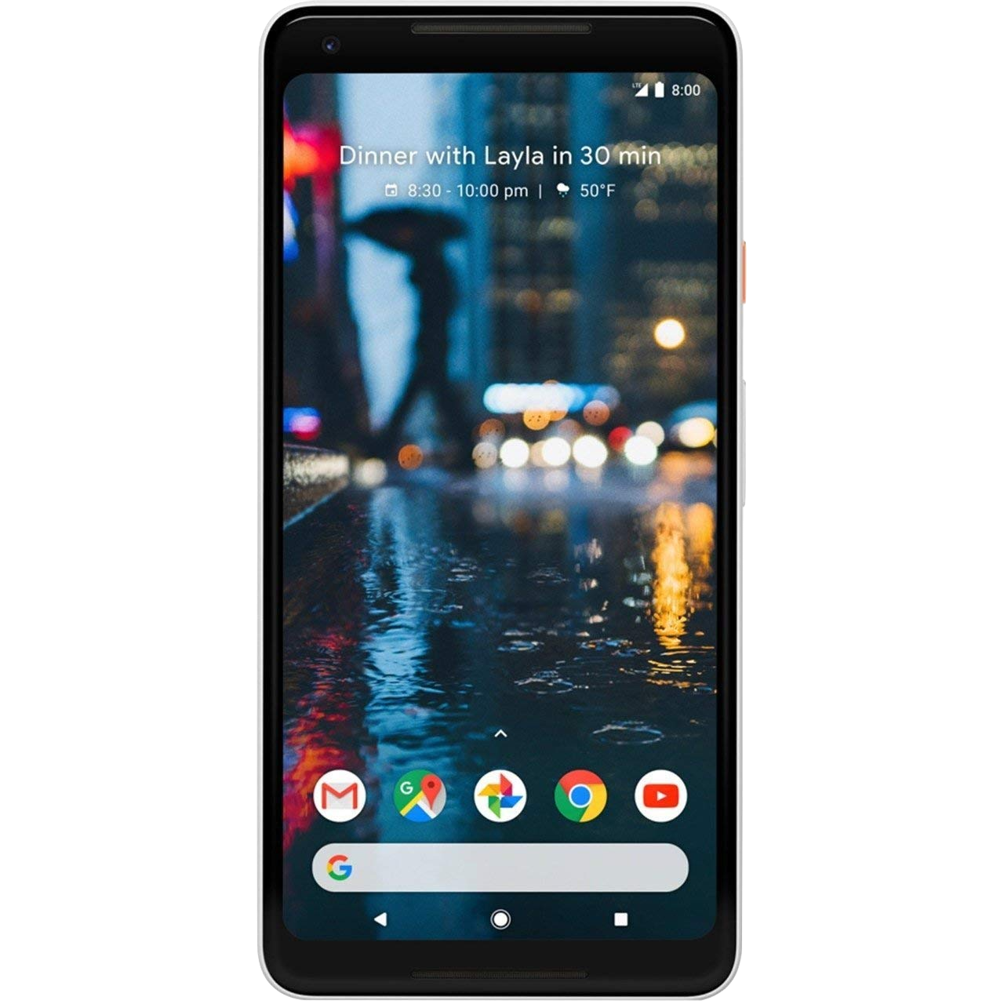
Notes:
https://search.creativecommons.org/photos/6e63331f-944b-4d61-8df3-5df190d63751

Slide 6
Less memory
Less compute power
Only focused on inference
Notes:
https://search.creativecommons.org/photos/6e63331f-944b-4d61-8df3-5df190d63751

Slide 7
Key Differences
Topology
Variable
Fixed
Weights
Variable
Fixed
Binary Size
Unimportant
High Priority
Distributed Compute
Not
Needed
Needed
Developer Background
ML
Researcher
Application
Developer

Slide 8
Key Differences
Topology
Variable
Fixed
Weights
Variable
Fixed
Binary Size
Unimportant
High Priority
Distributed Compute
Not
Needed
Needed
Developer Background
ML
Researcher
Application
Developer

Slide 9
Key Differences
Topology
Variable
Fixed
Weights
Variable
Fixed
Binary Size
Unimportant
High Priority
Distributed Compute
Not
Needed
Needed
Developer Background
ML
Researcher
Application
Developer

Slide 10
Key Differences
Topology
Variable
Fixed
Weights
Variable
Fixed
Binary Size
Unimportant
High Priority
Distributed Compute
Not
Needed
Needed
Developer Background
ML
Researcher
Application
Developer

Slide 11
Key Differences
Topology
Variable
Fixed
Weights
Variable
Fixed
Binary Size
Unimportant
High Priority
Distributed Compute
Not
Needed
Needed
Developer Background
ML
Researcher
Application
Developer

Slide 12
TF vs. TF Lite
Model
Software
Hardware

Slide 13
TF vs. TF Lite
Model
Software
Hardware

Slide 14
Training | Yes | No | No
Micro
Notes:
I would say as of today (whenever you record it), this is what the high-level differences are. For example
*How many ops --> 50 (but that could be because of eng resources)
*Delegation to accelerators --> Its no because microcontroller don't have accelerators yet. If we have microNPU, I don't see why the accelerator driver code can't be integrated within TFLite Micro.

Slide 15
Training | Yes | No | No
Inference | Yes (but inefficient on edge) | Yes (and efficient) | Yes (and even more efficient)
Micro
Notes:
I would say as of today (whenever you record it), this is what the high-level differences are. For example
*How many ops --> 50 (but that could be because of eng resources)
*Delegation to accelerators --> Its no because microcontroller don't have accelerators yet. If we have microNPU, I don't see why the accelerator driver code can't be integrated within TFLite Micro.

Slide 16
Training | Yes | No | No
Inference | Yes (but inefficient on edge) | Yes (and efficient) | Yes (and even more efficient)
How Many Ops | ~1400 | ~130 | ~50
Micro
Notes:
I would say as of today (whenever you record it), this is what the high-level differences are. For example
*How many ops --> 50 (but that could be because of eng resources)
*Delegation to accelerators --> Its no because microcontroller don't have accelerators yet. If we have microNPU, I don't see why the accelerator driver code can't be integrated within TFLite Micro.

Slide 17
Training | Yes | No | No
Inference | Yes (but inefficient on edge) | Yes (and efficient) | Yes (and even more efficient)
How Many Ops | ~1400 | ~130 | ~50
Native Quantization Tooling + Support | No | Yes | Yes
Micro
Notes:
I would say as of today (whenever you record it), this is what the high-level differences are. For example
*How many ops --> 50 (but that could be because of eng resources)
*Delegation to accelerators --> Its no because microcontroller don't have accelerators yet. If we have microNPU, I don't see why the accelerator driver code can't be integrated within TFLite Micro.

Slide 18
TF vs. TF Lite
Model
Software
Hardware

Slide 19
Needs an OS | Yes | Yes | No
Micro
Notes:
I would say as of today (whenever you record it), this is what the high-level differences are. For example
*How many ops --> 50 (but that could be because of eng resources)
*Delegation to accelerators --> Its no because microcontroller don't have accelerators yet. If we have microNPU, I don't see why the accelerator driver code can't be integrated within TFLite Micro.

Slide 20
Needs an OS | Yes | Yes | No
Memory Mapping of Models | No | Yes | Yes
Micro
Notes:
I would say as of today (whenever you record it), this is what the high-level differences are. For example
*How many ops --> 50 (but that could be because of eng resources)
*Delegation to accelerators --> Its no because microcontroller don't have accelerators yet. If we have microNPU, I don't see why the accelerator driver code can't be integrated within TFLite Micro.

Slide 21
Needs an OS | Yes | Yes | No
Memory Mapping of Models | No | Yes | Yes
Delegation to accelerators | Yes | Yes | No
Micro
Notes:
I would say as of today (whenever you record it), this is what the high-level differences are. For example
*How many ops --> 50 (but that could be because of eng resources)
*Delegation to accelerators --> Its no because microcontroller don't have accelerators yet. If we have microNPU, I don't see why the accelerator driver code can't be integrated within TFLite Micro.

Slide 22
TF vs. TF Lite
Model
Software
Hardware

Slide 23
Base Binary Size | 3MB+ | 100KB | ~10 KB
Micro
Notes:
I would say as of today (whenever you record it), this is what the high-level differences are. For example
*How many ops --> 50 (but that could be because of eng resources)
*Delegation to accelerators --> Its no because microcontroller don't have accelerators yet. If we have microNPU, I don't see why the accelerator driver code can't be integrated within TFLite Micro.

Slide 24
Base Binary Size | 3MB+ | 100KB | ~10 KB
Base Memory Footprint | ~5MB | 300KB | 20KB
Micro
Notes:
I would say as of today (whenever you record it), this is what the high-level differences are. For example
*How many ops --> 50 (but that could be because of eng resources)
*Delegation to accelerators --> Its no because microcontroller don't have accelerators yet. If we have microNPU, I don't see why the accelerator driver code can't be integrated within TFLite Micro.

Slide 25
Base Binary Size | 3MB+ | 100KB | ~10 KB
Base Memory Footprint | ~5MB | 300KB | 20KB
Optimized Architectures | X86, TPUs, GPUs | Arm Cortex A, x86 | Arm Cortex M, DSPs, MCUs
Micro
Notes:
I would say as of today (whenever you record it), this is what the high-level differences are. For example
*How many ops --> 50 (but that could be because of eng resources)
*Delegation to accelerators --> Its no because microcontroller don't have accelerators yet. If we have microNPU, I don't see why the accelerator driver code can't be integrated within TFLite Micro.

